Slide 1
Face mask detection by comparing machine learning and deep learning
Naga sai surya sujith nedunuri
W9434708
School of computing
Teesside university

Slide 2
Problem statement
Covid-19 is one of the contagious diseases which transmits easily from one individual to another if they come near in contact in close parameters. To protect ourselves from the spread of Covid-19, wearing a well fitted facemask properly is recommended and made mandatory in public areas. So, the need for a facemask detection system is increased as it can help the people to assist and alert them to wear a facemask properly by covering the nose and mouth.

Slide 3
Abstract
To prevent the spread of coronavirus from one person to another, a facemask must be always worn while stepping out into public areas. This research aims to design a facemask detection system which can analyze the facemask whether it is worn correctly or incorrectly or not. To implement this system, a machine learning and deep learning approaches are considered. KNN & Decision Tree are one of the classification algorithms that are used for machine learning approach and a pretrained deep learning model ResNet-50 v2 via Transfer Learning is considered. The model that gives the best accuracy will be deployed to classify the facemasks effectively for a real time video testing and image classification. The developed system can detect the facemask on people and classify them accurately if the person has worn the mask properly or improperly or not.

Slide 4
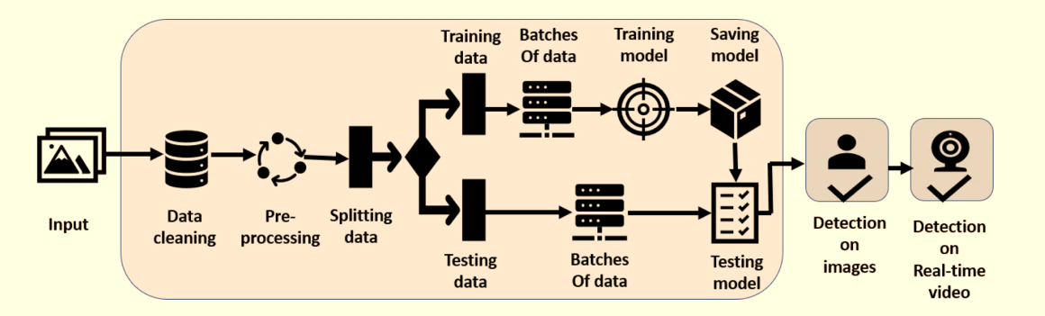
Graphical Abstract

Slide 5
Objectives
To investigate previous research papers for the techniques to understand the facial pattern feature extractions, algorithms that are used in facial recognition, and machine learning classifiers to predict the proper wearing of face masks and how they are implemented.
To explore the possible outcomes of ResNet50V2 neural network via Transfer Learning for image classification and for facial recognition in python.
To design and implement the facemask recognition and classification by choosing the best model among ResNet50V2, KNN and Decision Tree.
The designed system should identify the facemask on people and alert them if the nose or mouth is not covered properly by facemask, and also detecting the properly wearing mask and no mask at all. It should classify into 3 categories i.e., Correct Mask / Incorrect Mask / No Mask.
To evaluate the face mask detection system by validating the predicted result of the system by wearing face mask in different angles on real time video streaming and on classifying the images.

Slide 6
Existing System
In recent months, facemask identification models, which became a significant model during the COVID-19 pandemic, has gotten a high attention. The face mask detection process can be divided into two categories. The initial task is to detect the faces and the next task is to identify the if the facemask worn or not.
The fine-tuning of the models like AlexNet, MobileNet has been implemented via Transfer Learning which were pretrained on ImageNet to classify whether the facemask is worn or not.
Putting face masks impacted the accuracy of masked face classification with the Principal Component Analysis. When face mask is worn, the overall accuracy falls to 70%.
Facemask classification with MATLAB gave 98% accuracy while detecting whether the facemask is worn or not.

Slide 7
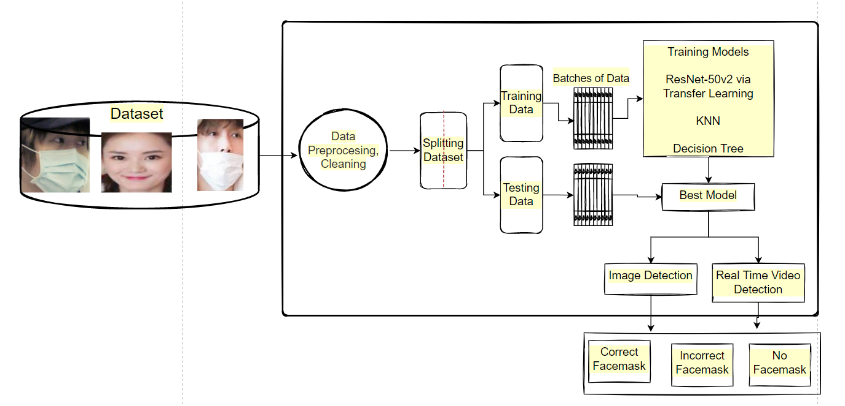
Proposed System

Slide 8
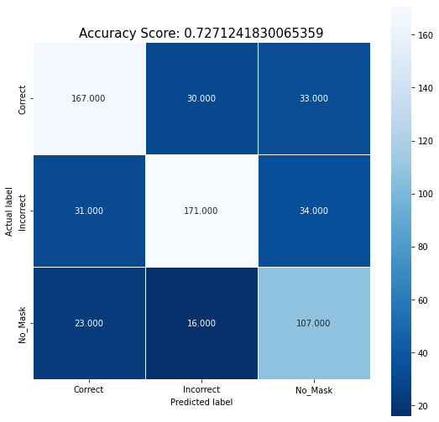
With decision tree
Accuracy Report | Precision. | Recall. | f1-score. | Support.
Correct. | 0.76 | 0.73 | 0.74 | 230
Incorrect. | 0.79 | 0.72 | 0.75 | 236
No Mask. | 0.61 | 0.73 | 0.67 | 146
Accuracy. |  |  | 0.73 | 612
Macro avg. | 0.72 | 0.73 | 0.72 | 612
Weighted avg. | 0.73 | 0.73 | 0.73 | 612

Slide 9
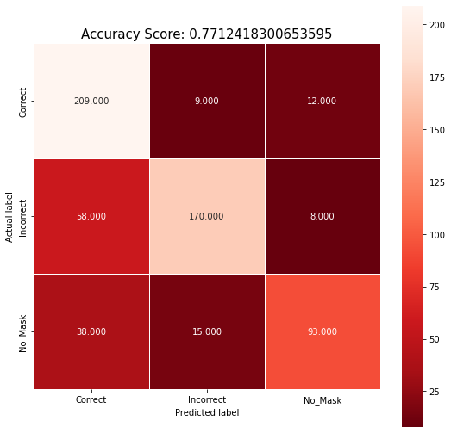
With knn
Accuracy Report | Precision. | Recall. | f1-score. | Support.
Correct. | 0.69 | 0.91 | 0.78 | 230
Incorrect. | 0.88 | 0.72 | 0.79 | 236
No Mask. | 0.82 | 0.64 | 0.72 | 146
Accuracy. |  |  | 0.77 | 612
Macro avg. | 0.79 | 0.76 | 0.76 | 612
Weighted avg. | 0.79 | 0.77 | 0.77 | 612

Slide 10
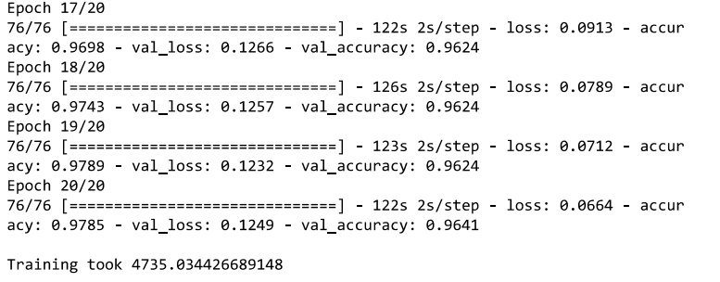
Less training time when compared with other pretrained models
With resnet-50 v2

Slide 11
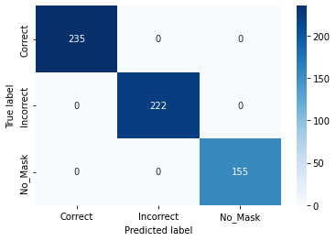
High Accuracy
With resnet-50 v2
Precise Classification
 | Precision. | Recall. | F1-score. | Support.
Correct. | 0.93 | 0.99 | 0.96 | 235
Incorrect. | 0.99 | 0.92 | 0.95 | 222
No Mask. | 0.99 | 0.99 | 0.99 | 155
Accuracy. |  |  | 0.96 | 612
macro avg. | 0.97 | 0.97 | 0.97 | 612
weighted avg. | 0.97 | 0.96 | 0.96 | 612

Slide 12
Accuracy Comparison

Slide 13
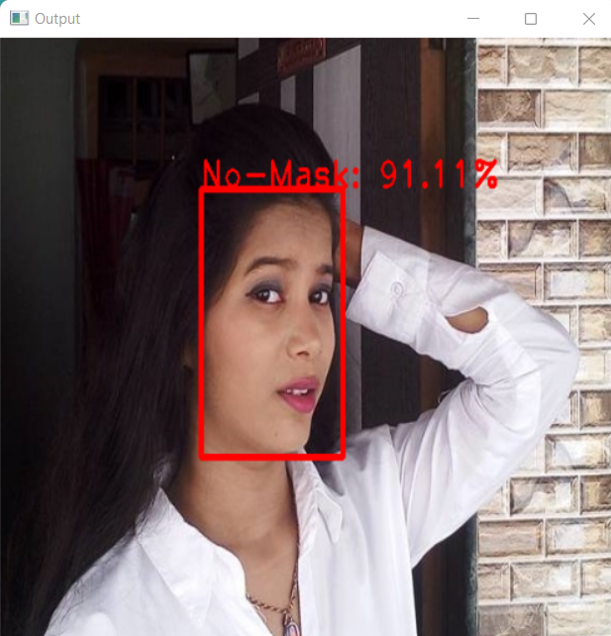
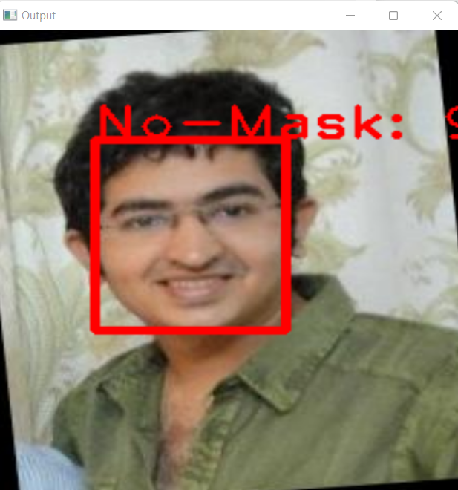
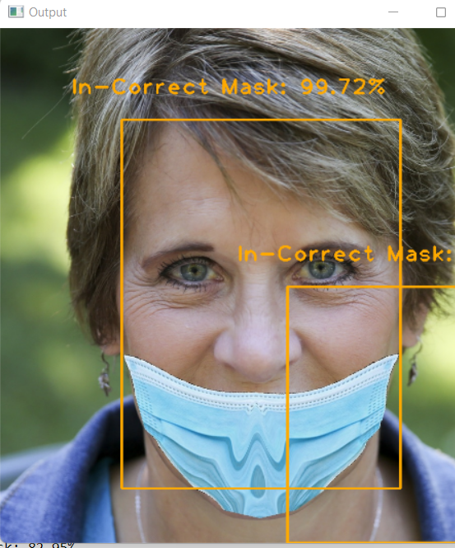
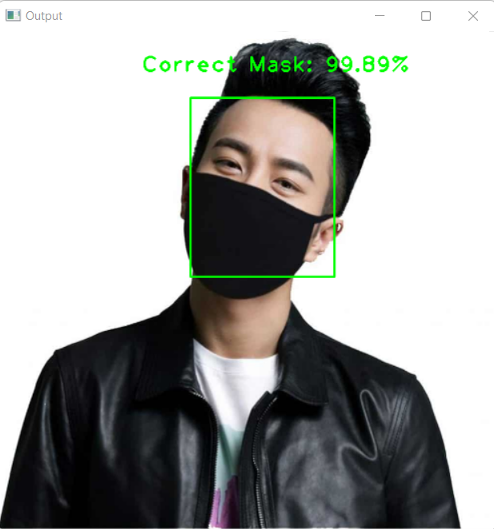
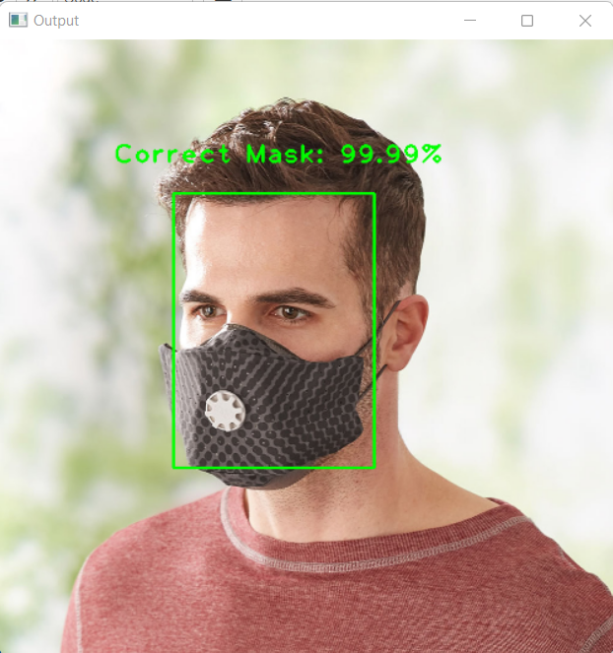
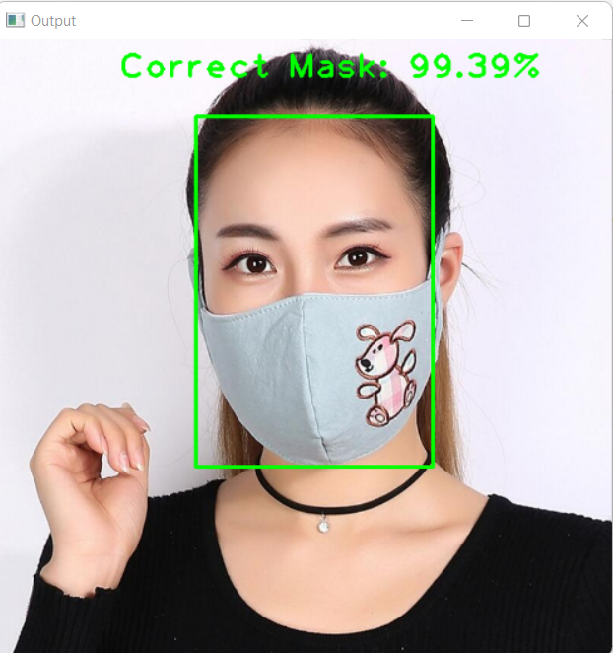
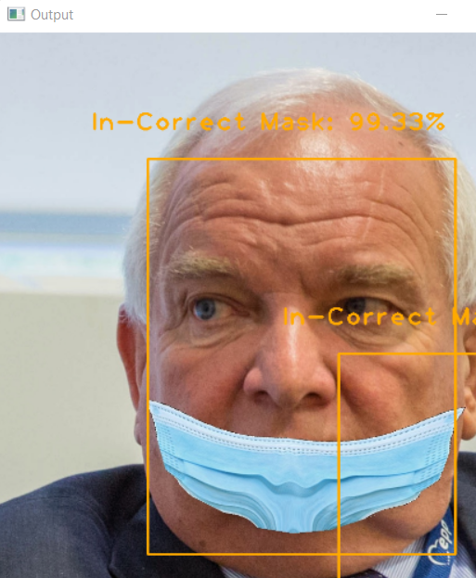
Testing with Resnet-50v2
Image Classification

Slide 14
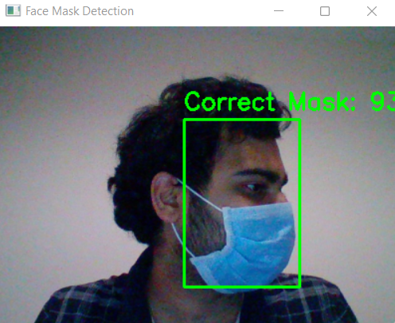
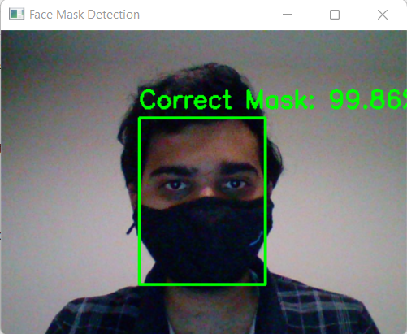
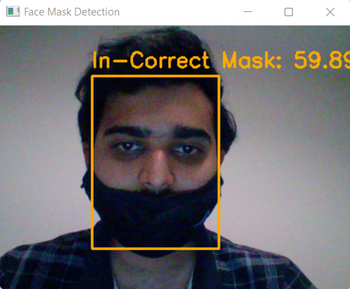
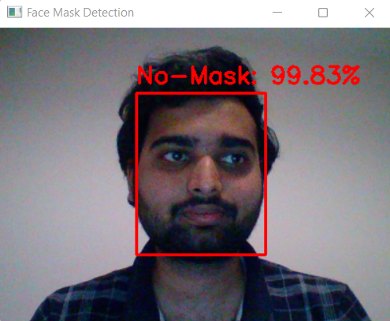
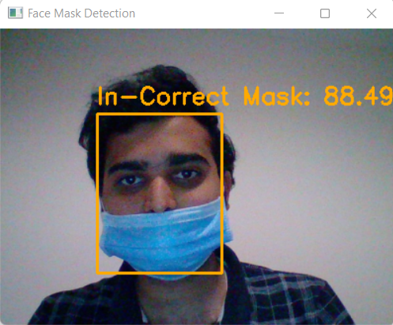
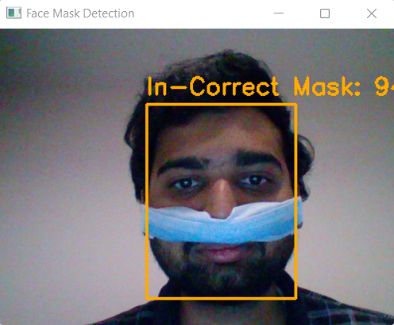
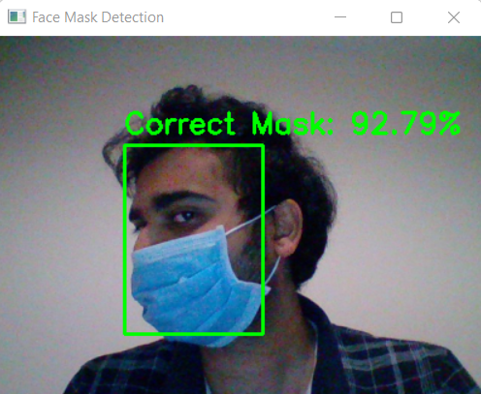
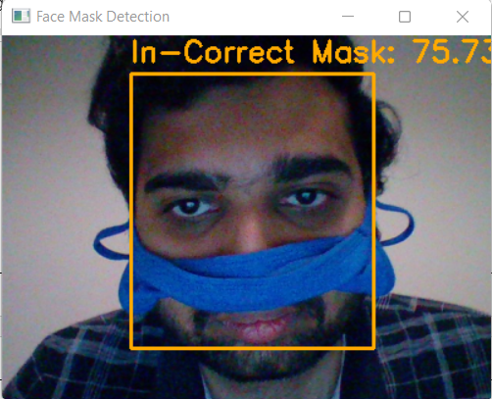
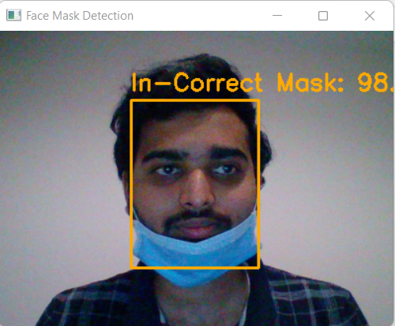
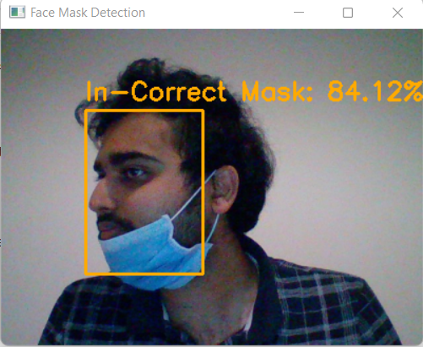
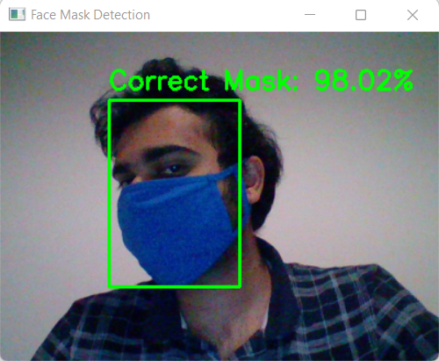
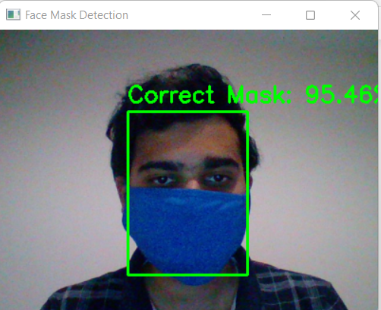
Testing with Resnet-50v2
Real Time Video Classification

Slide 15
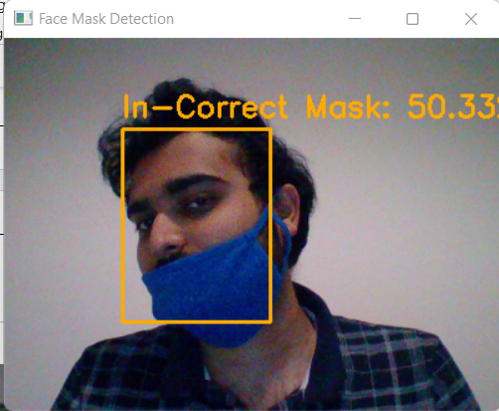
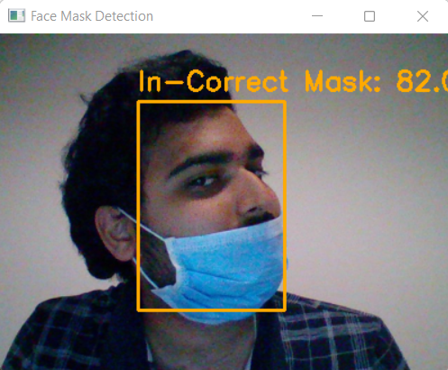
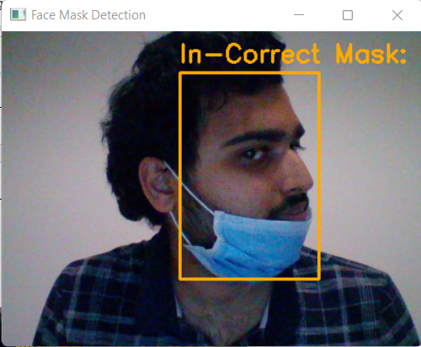
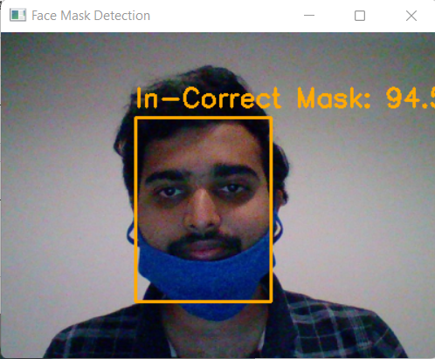
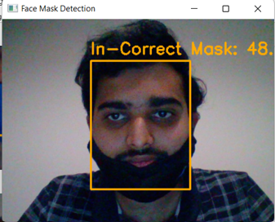
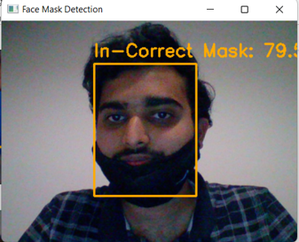
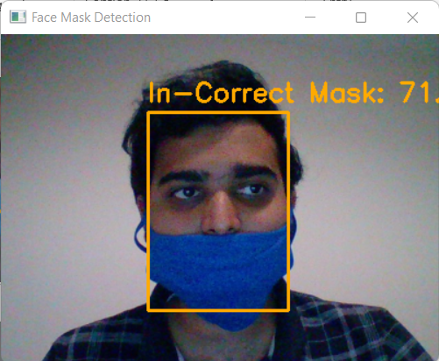
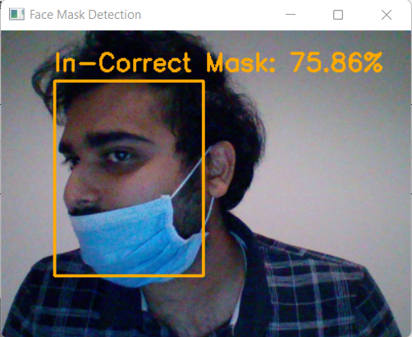
Output Video Link: https://vimeo.com/705401275/77f6d04f39

Slide 16
Live Demo

Slide 17
Conclusion
The objectives are achieved.
The developed system can recognize and able to distinguish the facemasks properly.
The developed system can detect Improper facemasks at different angles when the nose or mouth is exposed along with the Proper wearing of mask and with No Mask at high accuracy 99%.
The system can detect the facemask from the input images and able to classify.
The system can detect the facemask on real time video streaming.

Slide 18
Thank you.

